Slide 1
Automatic Thyroid Ultrasound Image Classification Using Feature Fusion Network

Slide 2
Abstract
Nowadays, diagnosis of thyroid nodules is mainly based on clinical methods, which requires a lot of manpower and medical resources. Therefore, this work proposes an automated thyroid ultrasound nodule diagnosis method that combines convolutional neural networks and image texture features. The main steps include: Firstly, ultrasound thyroid nodule dataset is established by collecting positive and negative samples, standardizing of images and segmentation of nodule area. Secondly, through texture features extraction, feature selection and data dimensionality reduction, texture features model is obtained; Thirdly, by transfer learning, deep neural network is used to obtain feature model of the nodule in images; Then, texture features model and convolutional neural network feature model are combined to form a new nodule feature model called Feature Fusion Network; Finally, Feature Fusion Network is applied to train and improve performance than single network, and a deep neural network diagnosis model that can adapt to the characteristics of thyroid nodules is built.

Slide 3
INTRODUCTION
With the increase of people’s life pressure, prevalence of thyroid nodules has increased year by year in the world. It has become one of the most important diseases and is threatening human health [1]. Therefore, early diagnosis of thyroid nodules is very important [2]. The diagnostic methods of thyroid nodules mainly include ultrasound examination, CT examination, aspiration biopsy and pathological examination. CT examination requires nuclear scanning, which is harmful to patients and is expensive. Needle biopsy and pathological examination are more commonly used and reliable methods, but these two methods are very traumatic to thyroid tissue. Also, their diagnosis process is cumbersome, which will occupy more medical resources. Ultrasonography is currently the common imaging method for diagnosing thyroid diseases. It has the advantages of simplicity, good reproducibility, non-invasive, fast and low price.

Slide 4
LITERATURE SURVEY
Geographic influences in the global rise of thyroid cancer:
https://www.nature.com/articles/s41574-019-0263-x
ABSTRACT: The incidence of thyroid cancer is on the rise, and this disease is projected to become the fourth leading type of cancer across the globe. From 1990 to 2013, the global age-standardized incidence rate of thyroid cancer increased by 20%. This global rise in incidence has been attributed to several factors, including increased detection of early tumours, the elevated prevalence of modifiable individual risk factors (for example, obesity) and increased exposure to environmental risk factors (for example, iodine levels).

Slide 5
LITERATURE SURVEY
Improving the accuracy of early diagnosis of thyroid nodule type based on the SCAD method
https://www.researchgate.net/publication/304931466_Improving_the_Accuracy_of_Early_Diagnosis_of_Thyroid_Nodule_Type_Based_on_the_SCAD_Method
ABSTRACT: Although early diagnosis of thyroid nodule type is very important, the diagnostic accuracy of standard tests is a challenging issue. We here aimed to find an optimal combination of factors to improve diagnostic accuracy for distinguishing malignant from benign thyroid nodules before surgery. In a prospective study from 2008 to 2012, 345 patients referred for thyroidectomy were enrolled.

Slide 6
LITERATURE SURVEY
A review of medical image detection for cancers in digestive system based on artificial intelligence
https://pubmed.ncbi.nlm.nih.gov/31530047/
ABSTRACT: At present, cancer imaging examination relies mainly on manual reading of doctors, which requests a high standard of doctors' professional skills, clinical experience, and concentration. However, the increasing amount of medical imaging data has brought more and more challenges to radiologists. The detection of digestive system cancer (DSC) based on artificial intelligence (AI) can provide a solution for automatic analysis of medical images and assist doctors to achieve high-precision intelligent diagnosis of cancers.

Slide 7
LITERATURE SURVEY
An intelligent platform for ultrasound diagnosis of thyroid nodules
https://www.researchgate.net/publication/343484594_An_intelligent_platform_for_ultrasound_diagnosis_of_thyroid_nodules
ABSTRACT: This paper proposed a non-segmentation radiological method for classification of benign and malignant thyroid tumors using B mode ultrasound data. This method aimed to combine the advantages of morphological information provided by ultrasound and convolutional neural networks in automatic feature extraction and accurate classification.

Slide 8
EXISTING SYSTEM
With the development of deep learning, some researchers are studying convolutional neural networks to diagnose thyroid ultrasound nodules. For example, Moran et al. established S-Detect technology based on the GoogLeNet. They cooperated with clinical sonographers for joint diagnosis to improve diagnostic performance. Xie et al. decomposed nodules into 9 views to learn 3D features. They built a multi-view knowledge-based collaborative model for each view and input three images into ResNet-50 network for training to represent appearance, voxel, and shape specificity. In summary, convolutional neural network usually does not require too much pre-processing operations, and has advantages of convenience and simplicity. However, it is very dependent on feature completeness of training data due to lack of sufficient prior theoretical support. In this case, direction and details of feature training are usually unknown. How to further improve diagnosis accuracy is still urgently needed.
DISADVANTAGES OF EXISTING SYSTEM:
However, it is very dependent on feature completeness of training data due to lack of sufficient prior theoretical support.
In this case, direction and details of feature training are usually unknown.
How to further improve diagnosis accuracy is still urgently needed

Slide 9
PROPOSED SYSTEM
This research suggests an automated thyroid ultrasonography nodule diagnosis technique that incorporates picture texture data and convolutional neural networks. The key actions consist of: By gathering both positive and negative samples, normalising the pictures, and segmenting the nodule area, the ultrasonography thyroid nodule dataset is first created. Second, a texture features model is created through the extraction of texture features, feature selection, and data dimensionality reduction; Thirdly, a deep neural network is employed to obtain a feature representation of the nodule in photos by transfer learning; Then, a new nodule feature model called Feature Fusion Network is created by fusing the texture and convolutional neural network feature models; A deep neural network diagnosis model that can adapt and feature fusion network are used to train and increase performance over single networks..
Advantages of proposed system:
Compared with traditional machine learning methods and convolutional neural networks, performance of this work is better.

Slide 10
REQUIRMENTS
SOFTWARE REQUIREMENTS
The functional requirements or the overall description documents include the product perspective and features, operating system and operating environment, graphics requirements, design constraints and user documentation.
The appropriation of requirements and implementation constraints gives the general overview of the project in regards to what the areas of strength and deficit are and how to tackle them.
Python idel 3.7 version (or)
Anaconda 3.7 ( or)
Jupiter (or)
Google colab

Slide 11
REQUIRMENTS
HARDWARE REQUIREMENTS
Minimum hardware requirements are very dependent on the particular software being developed by a given Enthought Python / Canopy / VS Code user. Applications that need to store large arrays/objects in memory will require more RAM, whereas applications that need to perform numerous calculations or tasks more quickly will require a faster processor.
Operating system : windows, linux
Processor : minimum intel i3
Ram : minimum 4 gb
Hard disk : minimum 250gb

Slide 12
ALGORITHMS
Feature Fusion ResNet: Feature fusion refers to the fusion of feature vectors of training images extracted from shared weight network layer and feature vectors composed of other numerical data, so that the proposed model can utilize features as many as possible for the further classification. ResNet is an artificial neural network that introduced a so-called “identity shortcut connection,” which allows the model to skip one or more layers. This approach makes it possible to train the network on thousands of layers without affecting performance.
Feature Fusion VGG16: VGG-16 is a convolutional neural network that is 16 layers deep. You can load a pretrained version of the network trained on more than a million images from the ImageNet database. The pretrained network can classify images into 1000 object categories, such as keyboard, mouse, pencil, and many animals.
VGG16 with Feed Forward Network Transfer Learning: VGG16 is a 16 layer transfer learning architecture and is quite similar to earlier architectures as it's foundation is based on CNN only but the arrangement is a bit different. The standard input image size which was taken by the researchers for this architecture was 224*224*3 where 3 represents the RGB channel.

Slide 13
ALGORITHMS
ResNet50: ResNet-50 is a convolutional neural network that is 50 layers deep. You can load a pretrained version of the network trained on more than a million images from the ImageNet database. The pretrained network can classify images into 1000 object categories, such as keyboard, mouse, pencil, and many animals.
VGG16: VGG-16 is a convolutional neural network that is 16 layers deep. You can load a pretrained version of the network trained on more than a million images from the ImageNet database. The pretrained network can classify images into 1000 object categories, such as keyboard, mouse, pencil, and many animals.
MobileNet V2: MobileNet-v2 is a convolutional neural network that is 53 layers deep. You can load a pretrained version of the network trained on more than a million images from the ImageNet database. The pretrained network can classify images into 1000 object categories, such as keyboard, mouse, pencil, and many animals.

Slide 14
ALGORITHMS
GAN: A generative adversarial network (GAN) is a machine learning (ML) model in which two neural networks compete with each other to become more accurate in their predictions. GANs typically run unsupervised and use a cooperative zero-sum game framework to learn.
KNN: The k-nearest neighbors algorithm, also known as KNN or k-NN, is a non-parametric, supervised learning classifier, which uses proximity to make classifications or predictions about the grouping of an individual data point.
LR: Logistic regression is a Machine Learning classification algorithm that is used to predict the probability of certain classes based on some dependent variables. In short, the logistic regression model computes a sum of the input features (in most cases, there is a bias term), and calculates the logistic of the result.
Voting Classifiers: A voting classifier is a machine learning estimator that trains various base models or estimators and predicts on the basis of aggregating the findings of each base estimator. The aggregating criteria can be combined decision of voting for each estimator output.

Slide 15
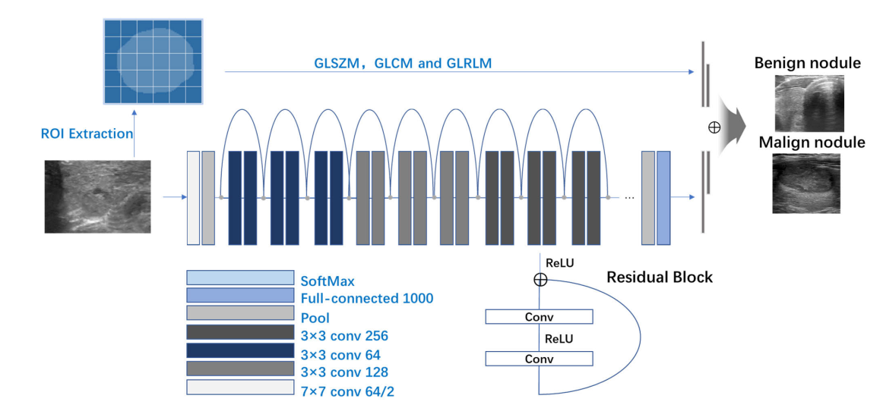
SYSTEM ARCHITECTURE

Slide 16
MODULES
Data exploration: using this module we will load data into system
Processing: Using the module we will read data for processing
Splitting data into train & test: using this module data will be divided into train & test
Model generation: Building the model - Feature Fusion ResNet, Feature Fusion VGG16, VGG16 with Feed Forward Network Transfer Learning, ResNet50, VGG16, MobileNet V2 and GAN
KNN, LR and Voting Classifiers. Algorithms accuracy calculted
User signup & login: Using this module will get registration and login
User input: Using this module will give input for prediction
Prediction: final predicted displayed

Slide 17
UML DIAGRAMS

Slide 18
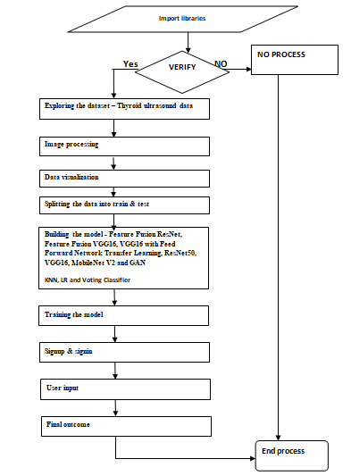
DATAFLOW DIAGRAM

Slide 19
USECASE DIAGRAM

Slide 20
CLASS DIAGRAM

Slide 21
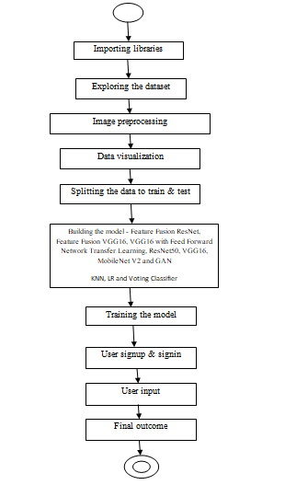
ACTIVITYDIAGRAM

Slide 22
SEQUENCE DIAGRAM

Slide 23
COLLABORATION DIAGRAM

Slide 24
COMPONENT DIAGRAM

Slide 25
DATAFLOW DIAGRAM

Slide 26
RESULTS

Slide 27
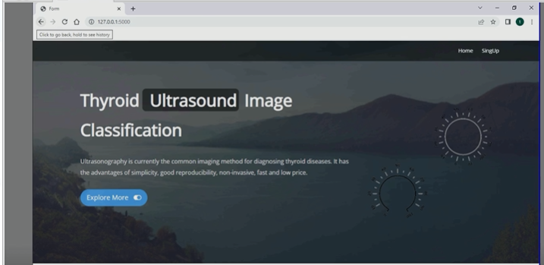

Slide 28
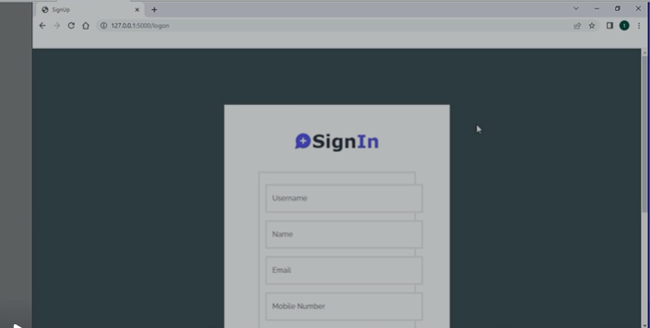

Slide 29
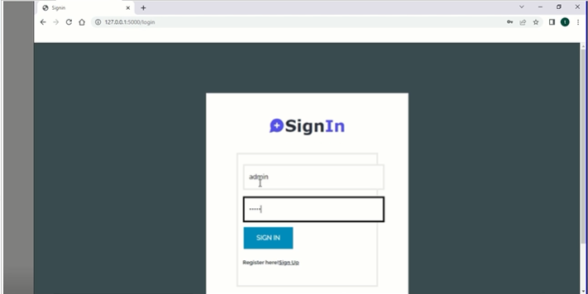

Slide 30
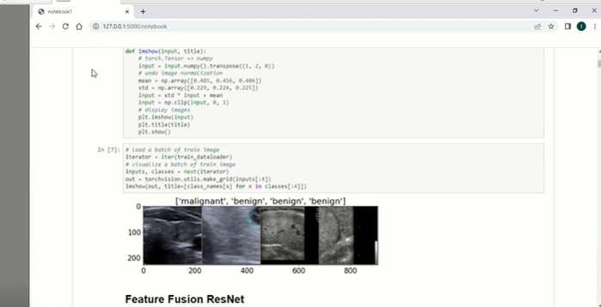

Slide 31
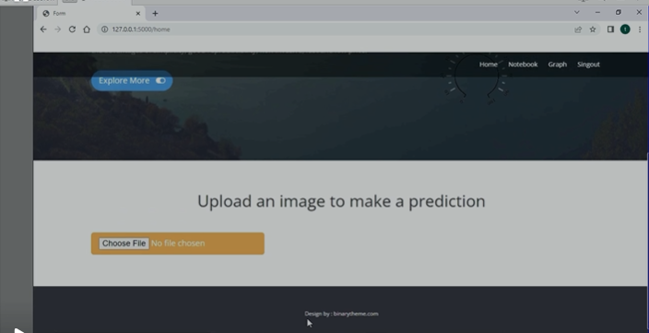

Slide 32
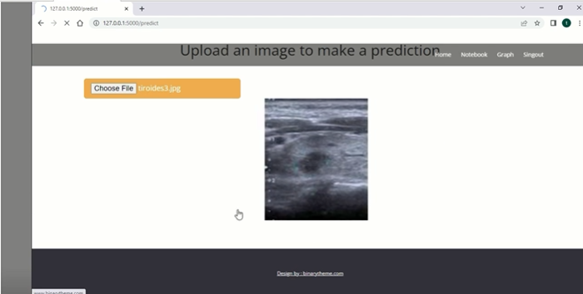

Slide 33
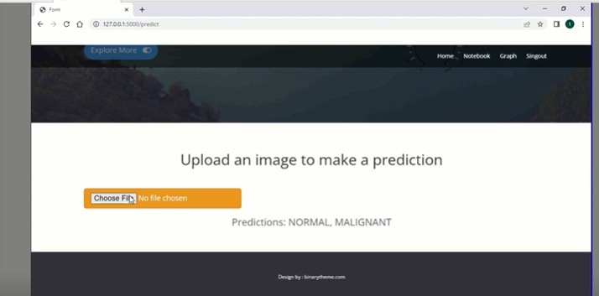

Slide 34
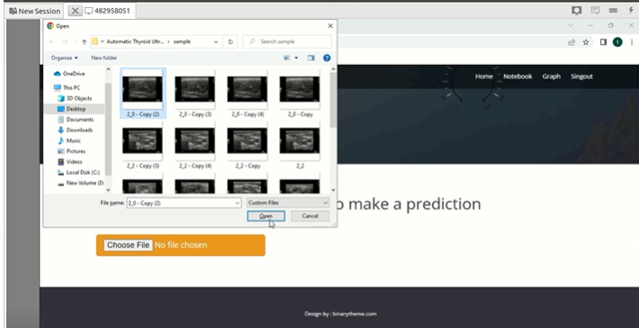

Slide 35
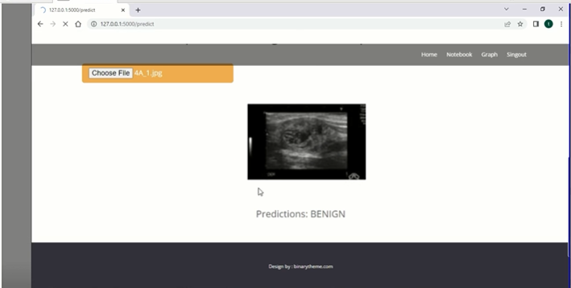

Slide 36
CONCLUSION
Since clinical diagnosis of benign and malignant thyroid nodules by ultrasound is a subjective and tedious process, this work aims to assist doctors in making clinical diagnosis of thyroid nodules, thereby improving the accuracy and efficiency of diagnosis. Firstly, it is necessary to preprocess the clinically collected data, including cropping, enhancement, and extraction of regions of interest. Then, feature engineering is applied to obtain texture features of nodules based on the nodules area, and feature dimensionality reduction is realized through the correlation between features and nodules. Finally, a deep neural network model is established, and texture features from the previous step are merged to achieve the goal of further improving network performance. Under assessment of 1874 cases with thyroid nodules, this method obtained the best performance, which has clinical potential. This work combines the advantages of feature engineering and deep neural networks, and proposes a novel way of fusing features.

Slide 37
REFERENCES
[1] J. Kim, J. E. Gosnell, and S. A. Roman, ‘‘Geographic influences in the global rise of thyroid cancer,’’ Nature Rev. Endocrinol., vol. 16, no. 1, pp. 17–29, Jan. 2020.
[2] H. R. Shahraki, S. Pourahmad, S. Paydar, and M. Azad, ‘‘Improving the accuracy of early diagnosis of thyroid nodule type based on the SCAD method,’’ Asian Pacific J. Cancer Prevention, vol. 17, no. 4, pp. 1861–1864, Jun. 2016.
[3] J. Xu, M. Jing, S. Wang, C. Yang, and X. Chen, ‘‘A review of medical image detection for cancers in digestive system based on artificial intelligence,’’ Expert Rev. Med. Devices, vol. 16, no. 10, pp. 877–889, Oct. 2019.
[4] H. Ye, J. Hang, X. Chen, D. Xu, J. Chen, X. Ye, and D. Zhang, ‘‘An intelligent platform for ultrasound diagnosis of thyroid nodules,’’ Sci. Rep., vol. 10, no. 1, Aug. 2020, Art. no. 13223.
[5] L. Wang, S. Yang, S. Yang, C. Zhao, G. Tian, Y. Gao, Y. Chen, and Y. Lu, ‘‘Automatic thyroid nodule recognition and diagnosis in ultrasound imaging with the YOLOv2 neural network,’’ World J. Surg. Oncol., vol. 17, no. 1, p. 12, Jan. 2019.

